Slide 1
Modular Super Resolution Fluorescent Microscopy
MSRFM
Tawab Karim

Slide 2
Introduction
Introduction
SRFM
EPI
TIRF
DMD
Future
Introduction to Super Resolution
Open Source Modular Microscope
Future plans
Notes:
Super resolution fluorescence microscopy is an adaptation of fluorescence microscopy. I’ll start of with a small introduction about what fluorescent microscopy is and tell a bit about the physical limit to how small of an object you are able to see. I will continue with how you can work your way around this physical limit. After this introduction I will tell you about the different setups that we’ve been working on the software that goes with it. And I will conclude with some future plans.

Slide 3
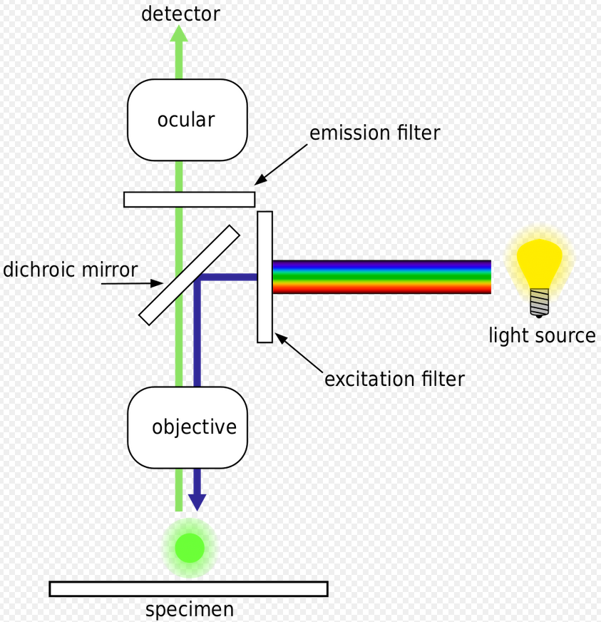
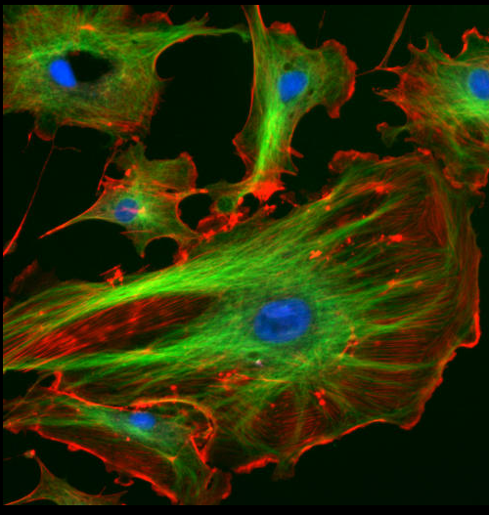
Fluorescence Microscopy
Introduction
SRFM
EPI
TIRF
DMD
Future
Notes:
Super resolution fluorescence microscopy is an adaptation of fluorescence microscopy. I’ll start of with a small intro

Slide 4
Fluorescence Microscopy
Introduction
SRFM
EPI
TIRF
DMD
Future
Advantages:
Specific labelling
Live cell microscopy
Notes:
Super resolution fluorescence microscopy is an adaptation of fluorescence microscopy. I’ll start of with a small intro

Slide 5
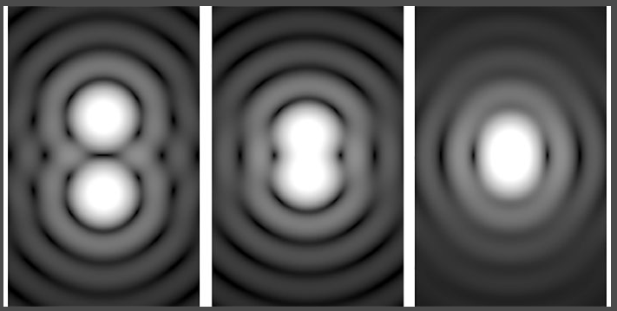
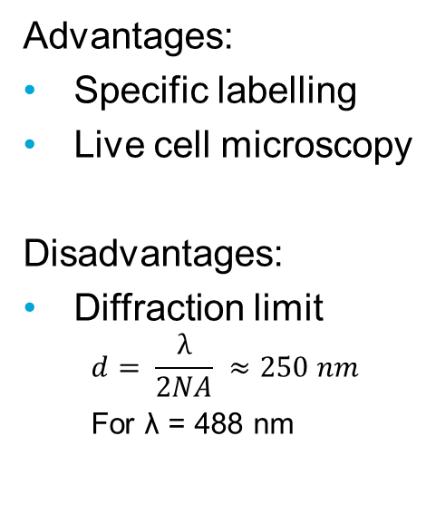
Fluorescence Microscopy
Introduction
SRFM
EPI
TIRF
DMD
Future
Advantages:
Specific labelling
Live cell microscopy
Disadvantages:
Diffraction limit
$$d= \frac{λ}{2NA} ≈250 nm$$
For λ = 488 nm
Notes:
Super resolution fluorescence microscopy is an adaptation of fluorescence microscopy. I’ll start of with a small intro

Slide 6
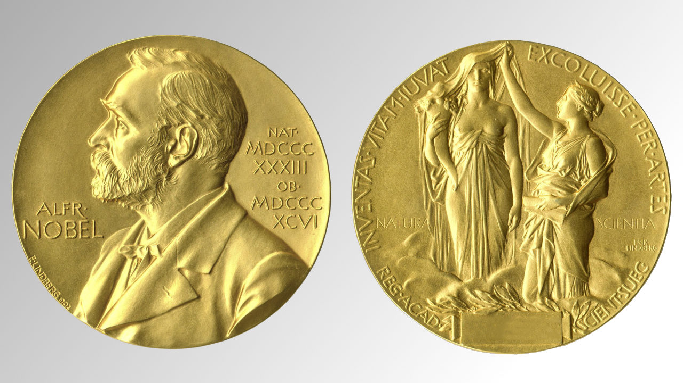
Super Resolution Fluorescence Microscopy
Introduction
SRFM
EPI
TIRF
DMD
Future
Localization Microscopy
Stochastic blinking of molecules
Estimate the molecules positions
3 μm
Notes:
Super resolution fluorescence microscopy is an adaptation of fluorescence microscopy. I’ll start of with a small int
MlE
Put in the nature paper
Put in about the nobel prize of 2014 icon

Slide 7
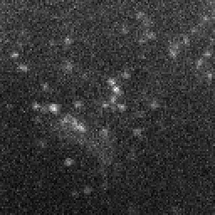
Super Resolution Fluorescence Microscopy
Introduction
SRFM
EPI
TIRF
DMD
Future
Localization Microscopy
Stochastic blinking of molecules
Estimate the molecules positions
t₁
3 μm
Notes:
Super resolution fluorescence microscopy is an adaptation of fluorescence microscopy. I’ll start of with a small int
MlE
Put in the nature paper
Put in about the nobel prize of 2014 icon

Slide 8
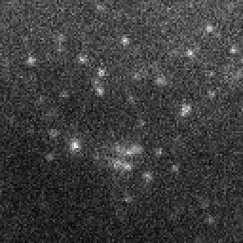
Super Resolution Fluorescence Microscopy
Introduction
SRFM
EPI
TIRF
DMD
Future
Localization Microscopy
Stochastic blinking of molecules
Estimate the molecules positions
t₁
t₂
3 μm
Notes:
Super resolution fluorescence microscopy is an adaptation of fluorescence microscopy. I’ll start of with a small int
MlE
Put in the nature paper
Put in about the nobel prize of 2014 icon

Slide 9
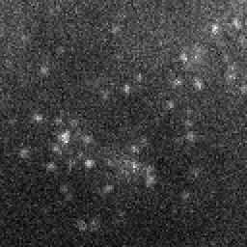
Super Resolution Fluorescence Microscopy
Introduction
SRFM
EPI
TIRF
DMD
Future
Localization Microscopy
Stochastic blinking of molecules
Estimate the molecules positions
t₁
t₂
t₃
3 μm
Notes:
Super resolution fluorescence microscopy is an adaptation of fluorescence microscopy. I’ll start of with a small int
MlE
Put in the nature paper
Put in about the nobel prize of 2014 icon

Slide 10




Super Resolution Fluorescence Microscopy
Introduction
SRFM
EPI
TIRF
DMD
Future
Localization Microscopy
Stochastic blinking of molecules
Estimate the molecules positions
t₁
t₂
t₃
…
…
3 μm
Notes:
Super resolution fluorescence microscopy is an adaptation of fluorescence microscopy. I’ll start of with a small int
MlE
Put in the nature paper
Put in about the nobel prize of 2014 icon

Slide 11
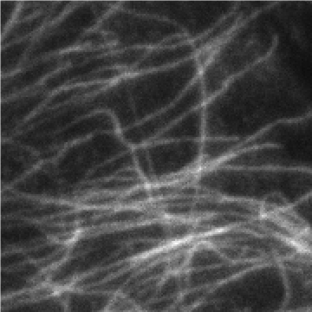
Super Resolution Fluorescence Microscopy
Introduction
SRFM
EPI
TIRF
DMD
Future
Localization Microscopy
Stochastic blinking of molecules
Estimate the molecules positions
t₁
t₂
t₃
…
…
3 μm
Notes:
Super resolution fluorescence microscopy is an adaptation of fluorescence microscopy. I’ll start of with a small int
MlE
Put in the nature paper
Put in about the nobel prize of 2014 icon

Slide 12
Super Resolution Fluorescence Microscopy
Introduction
SRFM
EPI
TIRF
DMD
Future
Localization Microscopy
Stochastic blinking of molecules
Estimate the molecules positions
t₁
x
x
t₂
t₃
x
x
…
…
3 μm
Notes:
Super resolution fluorescence microscopy is an adaptation of fluorescence microscopy. I’ll start of with a small int
MlE
Put in the nature paper
Put in about the nobel prize of 2014 icon

Slide 13
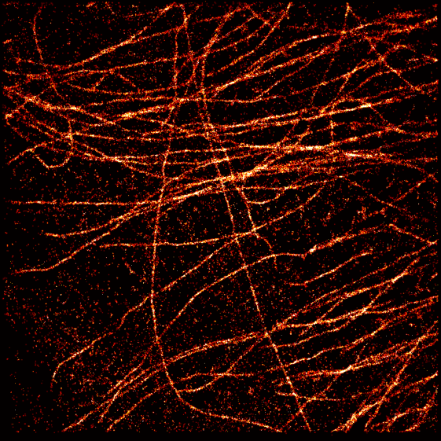
Super Resolution Fluorescence Microscopy
Introduction
SRFM
EPI
TIRF
DMD
Future
Localization Microscopy
Stochastic blinking of molecules
Estimate the molecules positions
t₁
x
x
t₂
t₃
x
x
…
…
3 μm
Notes:
Super resolution fluorescence microscopy is an adaptation of fluorescence microscopy. I’ll start of with a small int
MlE
Put in the nature paper
Put in about the nobel prize of 2014 icon

Slide 14


Super Resolution Fluorescent Microscopy
Introduction
SRFM
EPI
TIRF
DMD
Future
Lots of algorithms
Applications in Biology
Notes:
Pre build not flexible enough for research
Standard components from Thorlabs, expensive, to flexible (to many degrees of freedom).
Thinking about what you need and engineering to specs.
We develop a lot of algorithms here at DCSC, which we want to decamenate. Because we want bio to use it later on
Lo cost
Easy to build
Plug and play with algo
Thus modular

Slide 15
Super Resolution Fluorescent Microscopy
Introduction
SRFM
EPI
TIRF
DMD
Future
Lots of algorithms
Applications in Biology
Low cost
Easy to build
Plug and play with the algorithms
Notes:
Pre build not flexible enough for research
Standard components from Thorlabs, expensive, to flexible (to many degrees of freedom).
Thinking about what you need and engineering to specs.
We develop a lot of algorithms here at DCSC, which we want to decamenate. Because we want bio to use it later on
Lo cost
Easy to build
Plug and play with algo
Thus modular

Slide 16
Epi-fluorescent Microscopy
Introduction
SRFM
EPI
TIRF
DMD
Future
Fluorescent Microscope
Laser
Dichroic mirror
Objective
Camera
Notes:
Pre build not flexible enough for research
Standard components from Thorlabs, expensive, to flexible (to many degrees of freedom).
Thinking about what you need and engineering to specs.
We develop a lot of algorithms here at DCSC, which we want to decamenate. Because we want bio to use it later on
Lo cost
Easy to build
Plug and play with algo
Thus modular

Slide 17
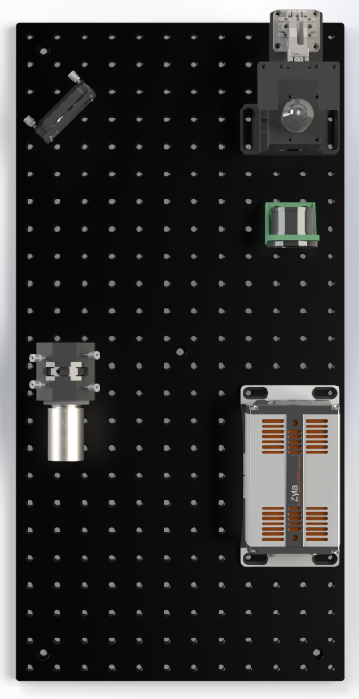
Epi-fluorescent Microscopy
Introduction
SRFM
EPI
TIRF
DMD
Future
Notes:
Pre build not flexible enough for research
Standard components from Thorlabs, expensive, to flexible (to many degrees of freedom).
Thinking about what you need and engineering to specs.
We develop a lot of algorithms here at DCSC, which we want to decamenate. Because we want bio to use it later on
Lo cost
Easy to build
Plug and play with algo
Thus modular

Slide 18
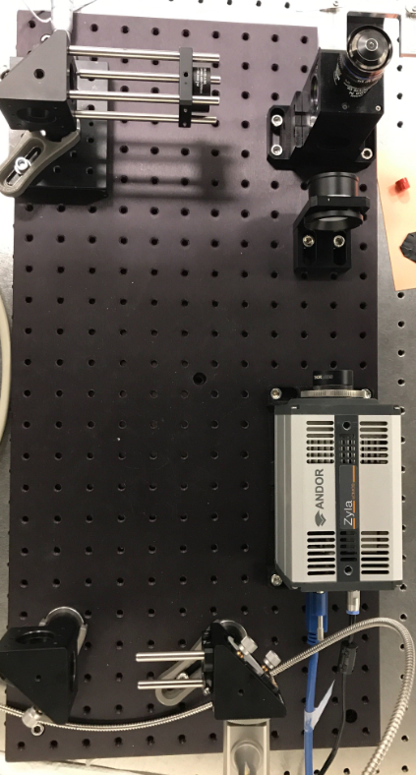
Epi-fluorescent Microscopy
Introduction
SRFM
EPI
TIRF
DMD
Future
Notes:
Pre build not flexible enough for research
Standard components from Thorlabs, expensive, to flexible (to many degrees of freedom).
Thinking about what you need and engineering to specs.
We develop a lot of algorithms here at DCSC, which we want to decamenate. Because we want bio to use it later on
Lo cost
Easy to build
Plug and play with algo
Thus modular

Slide 19
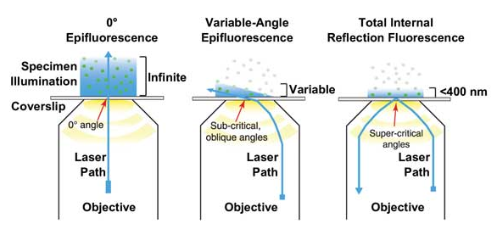
Total Internal Reflection Fluorescent Microscopy
Introduction
SRFM
EPI
TIRF
DMD
Future
Going from EPI to TIRF
Linear translation in excitation path needed
Notes:
Add in other slides with animation of how the linear stage causes the illumination path to shift

Slide 20
Total Internal Reflection Fluorescent Microscopy
Introduction
SRFM
EPI
TIRF
DMD
Future
Going from EPI to TIRF
Linear translation in excitation path needed
Notes:
Add in other slides with animation of how the linear stage causes the illumination path to shift

Slide 21
Total Internal Reflection Fluorescent Microscopy
Introduction
SRFM
EPI
TIRF
DMD
Future
Going from EPI to TIRF
Linear translation in excitation path needed
Notes:
Add in other slides with animation of how the linear stage causes the illumination path to shift

Slide 22
Total Internal Reflection Fluorescent Microscopy
Introduction
SRFM
EPI
TIRF
DMD
Future
Going from EPI to TIRF
Linear translation in excitation path needed
INSERT PICTURE
Notes:
Add in other slides with animation of how the linear stage causes the illumination path to shift

Slide 23
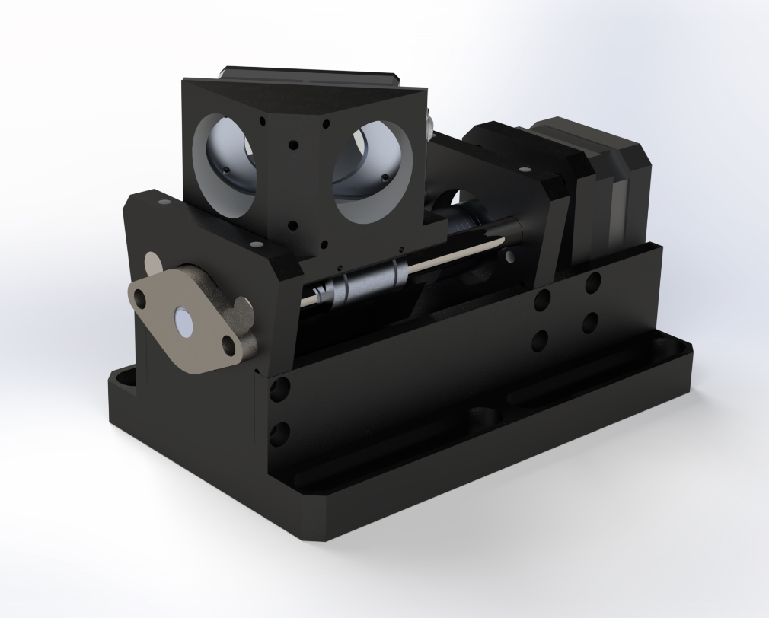
Total Internal Reflection Fluorescent Microscopy
Introduction
SRFM
EPI
TIRF
DMD
Future
Linear translation stage with controller
Specifications:
30 mm translation
Yaw angle adjustable
Modular
B-splines
Notes:
Make more clear the development between the different hardware setups, so show the progress via a render from above (fade the different components in fe)

Slide 24
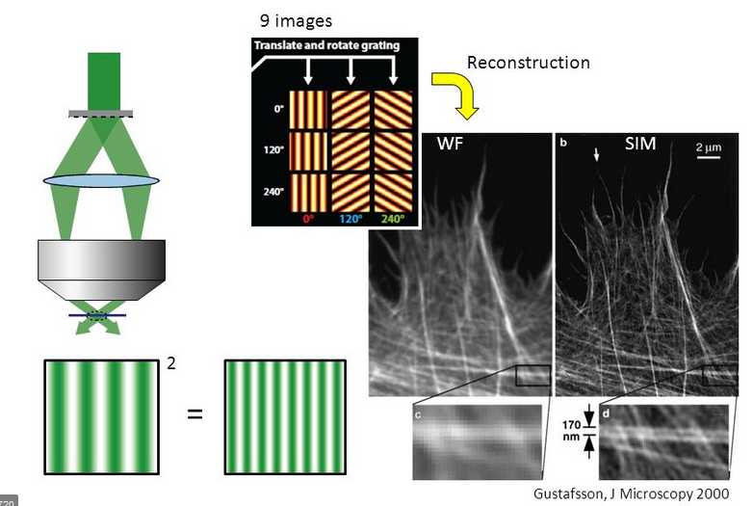
Digital Micromirror Device
Introduction
SRFM
EPI
TIRF
DMD
Future
Adds SIM/SIMFLUX possibilities
Notes:
Pre build not flexible enough for research
Standard components from Thorlabs, expensive, to flexible (to many degrees of freedom).
Thinking about what you need and engineering to specs.

Slide 25
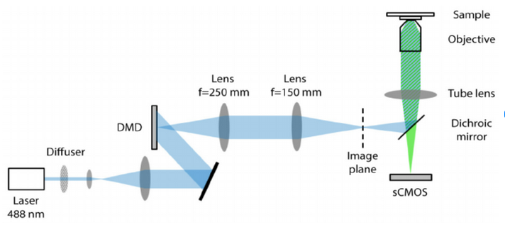
Digital Micromirror Device
Introduction
SRFM
EPI
TIRF
DMD
Future
Adds SIM/SIMFLUX possibilities
Notes:
Pre build not flexible enough for research
Standard components from Thorlabs, expensive, to flexible (to many degrees of freedom).
Thinking about what you need and engineering to specs.

Slide 26
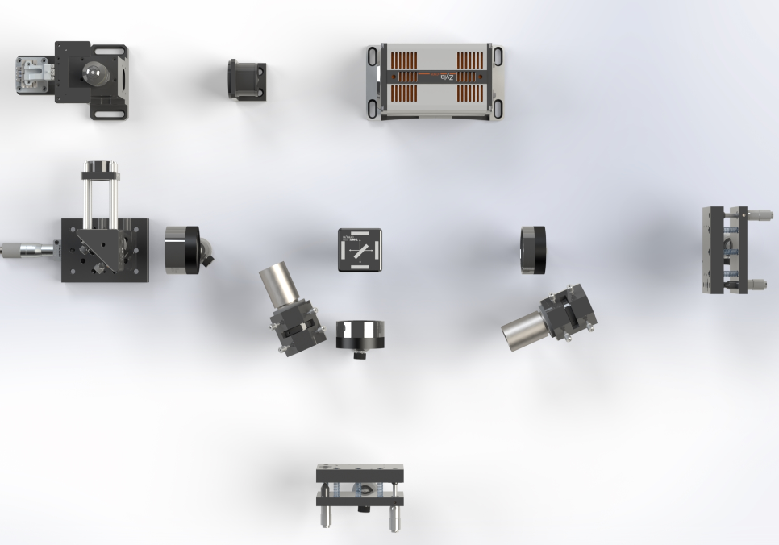
Digital Micromirror Device
Introduction
SRFM
EPI
TIRF
DMD
Future
Adds SIM/SIMFLUX possibilities
Notes:
Pre build not flexible enough for research
Standard components from Thorlabs, expensive, to flexible (to many degrees of freedom).
Thinking about what you need and engineering to specs.

Slide 27
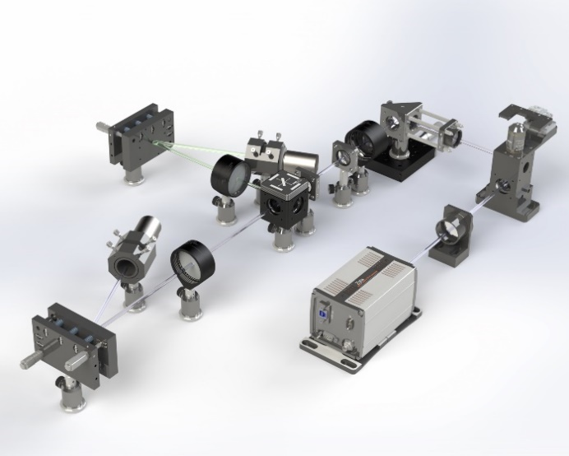
Digital Micromirror Device
Introduction
SRFM
EPI
TIRF
DMD
Future
Adds SIM/SIMFLUX possibilities
Notes:
Pre build not flexible enough for research
Standard components from Thorlabs, expensive, to flexible (to many degrees of freedom).
Thinking about what you need and engineering to specs.

Slide 28
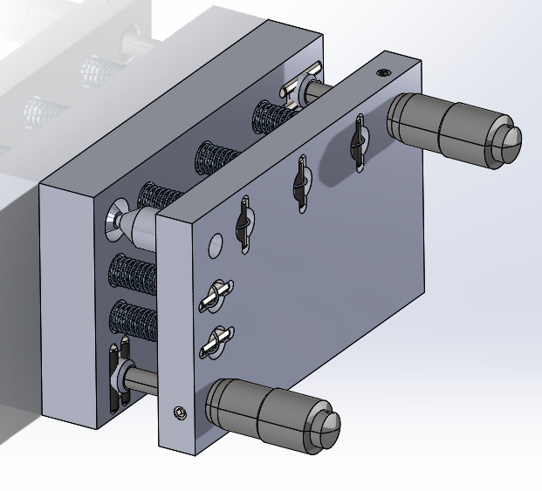
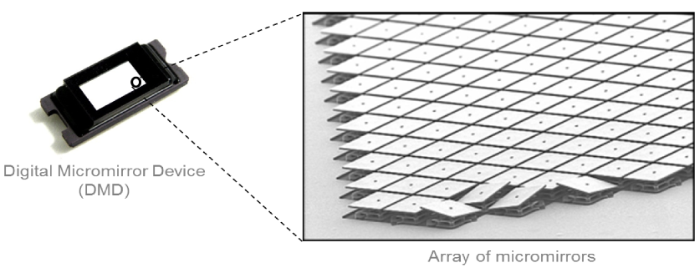
Digital Micromirror Device
Introduction
SRFM
EPI
TIRF
DMD
Future
Introducing a DMD to the setup.
Notes:
Pre build not flexible enough for research
Standard components from Thorlabs, expensive, to flexible (to many degrees of freedom).
Thinking about what you need and engineering to specs.

Slide 29
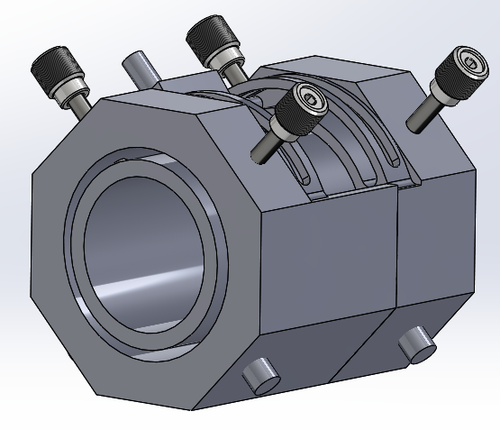
What is to come?
Introduction
SRFM
EPI
TIRF
DMD
AIM
DM
Future
More modularity
More microscopes
Ease of use
Notes:
Pre build not flexible enough for research
Standard components from Thorlabs, expensive, to flexible (to many degrees of freedom).
Thinking about what you need and engineering to specs.

Slide 30
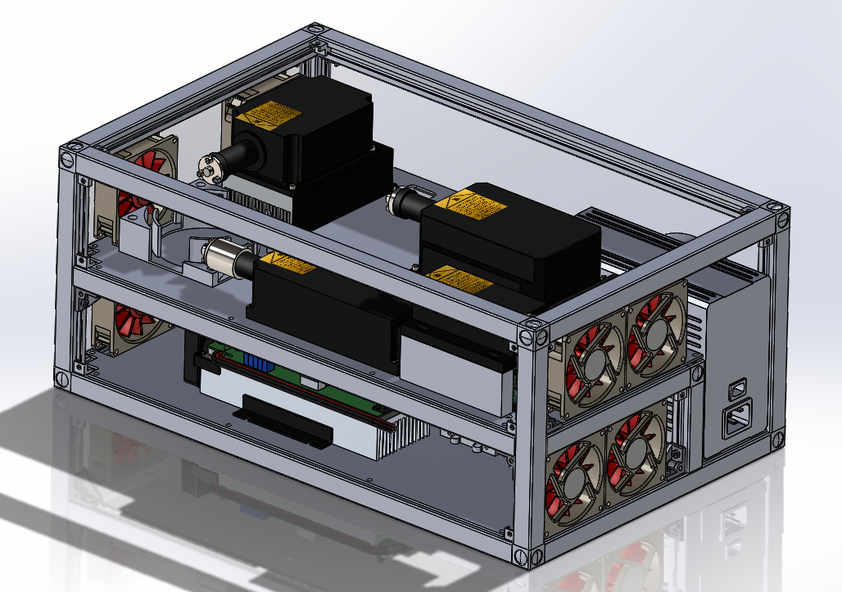
What is to come?
Introduction
SRFM
EPI
TIRF
DMD
AIM
DM
Future
More modularity
More microscopes
Ease of use
Multicolor
Website
Notes:
Pre build not flexible enough for research
Standard components from Thorlabs, expensive, to flexible (to many degrees of freedom).
Thinking about what you need and engineering to specs.

Slide 31
What is to come?
Introduction
SRFM
EPI
TIRF
DMD
AIM
DM
Future
More modularity
More microscopes
Ease of use
Multicolor
Website
And much more!
Notes:
Pre build not flexible enough for research
Standard components from Thorlabs, expensive, to flexible (to many degrees of freedom).
Thinking about what you need and engineering to specs.

Slide 32
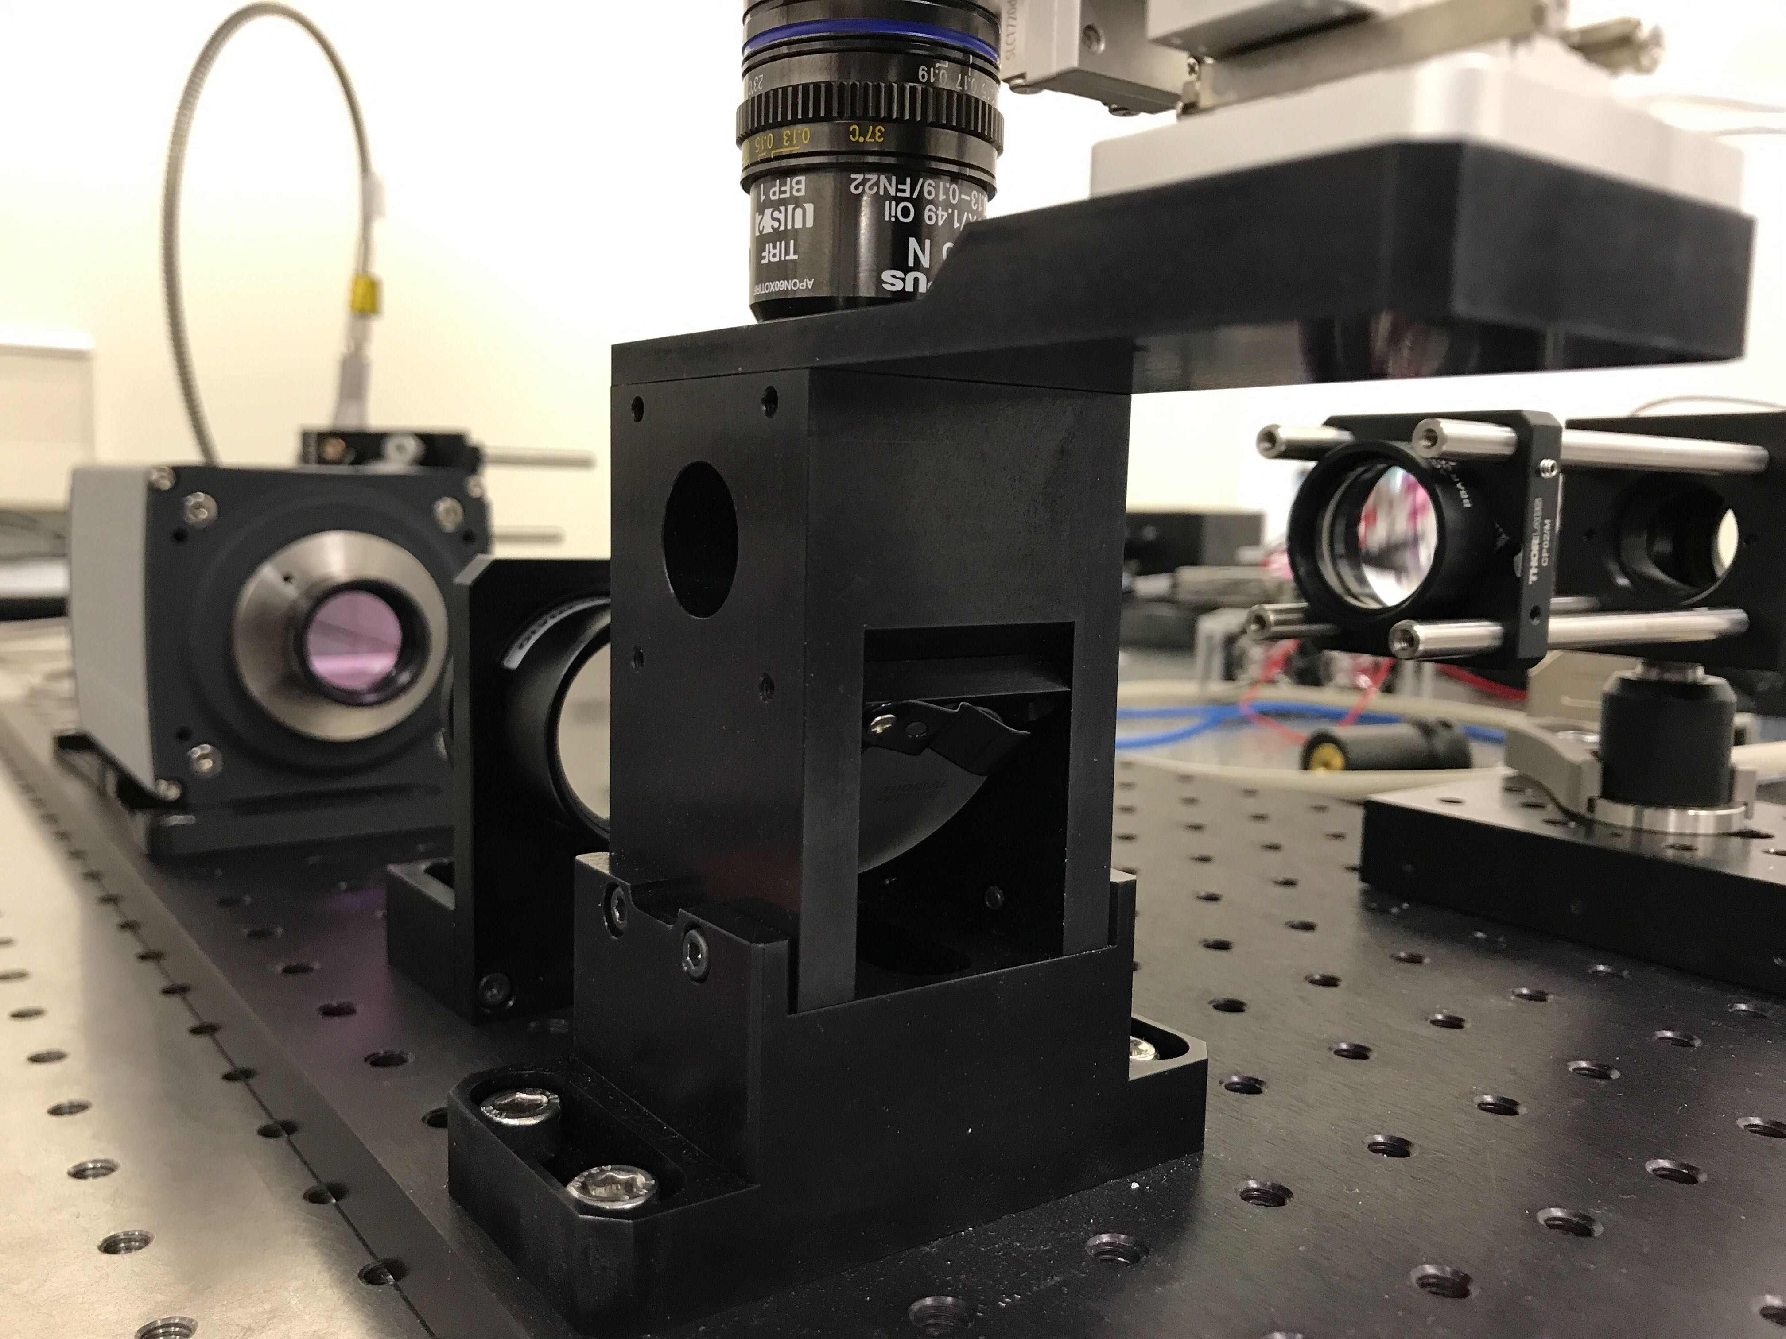
Questions?
Introduction
SRFM
EPI
TIRF
DMD
AIM
DM
Future
Notes:
Pre build not flexible enough for research
Standard components from Thorlabs, expensive, to flexible (to many degrees of freedom).
Thinking about what you need and engineering to specs.

